Slide 1

WELCOME
P. Harikrishna

Slide 2
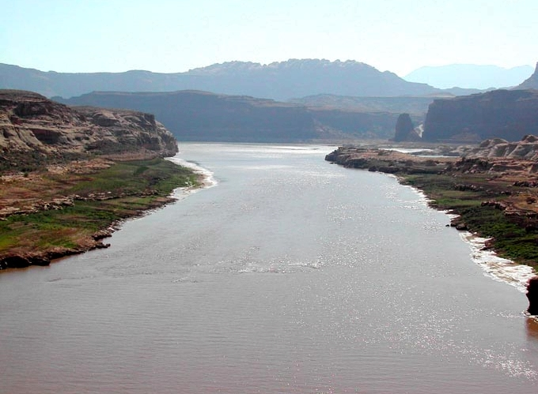
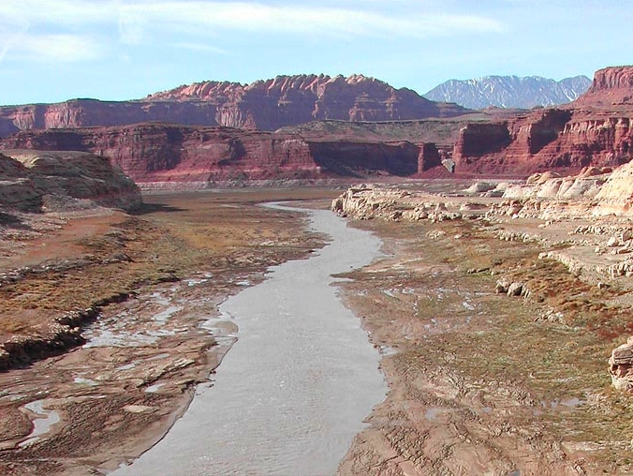
GLOBAL WARMING
Arizona
Assistant Professor Department of English NSS College, Pandalam

Slide 3
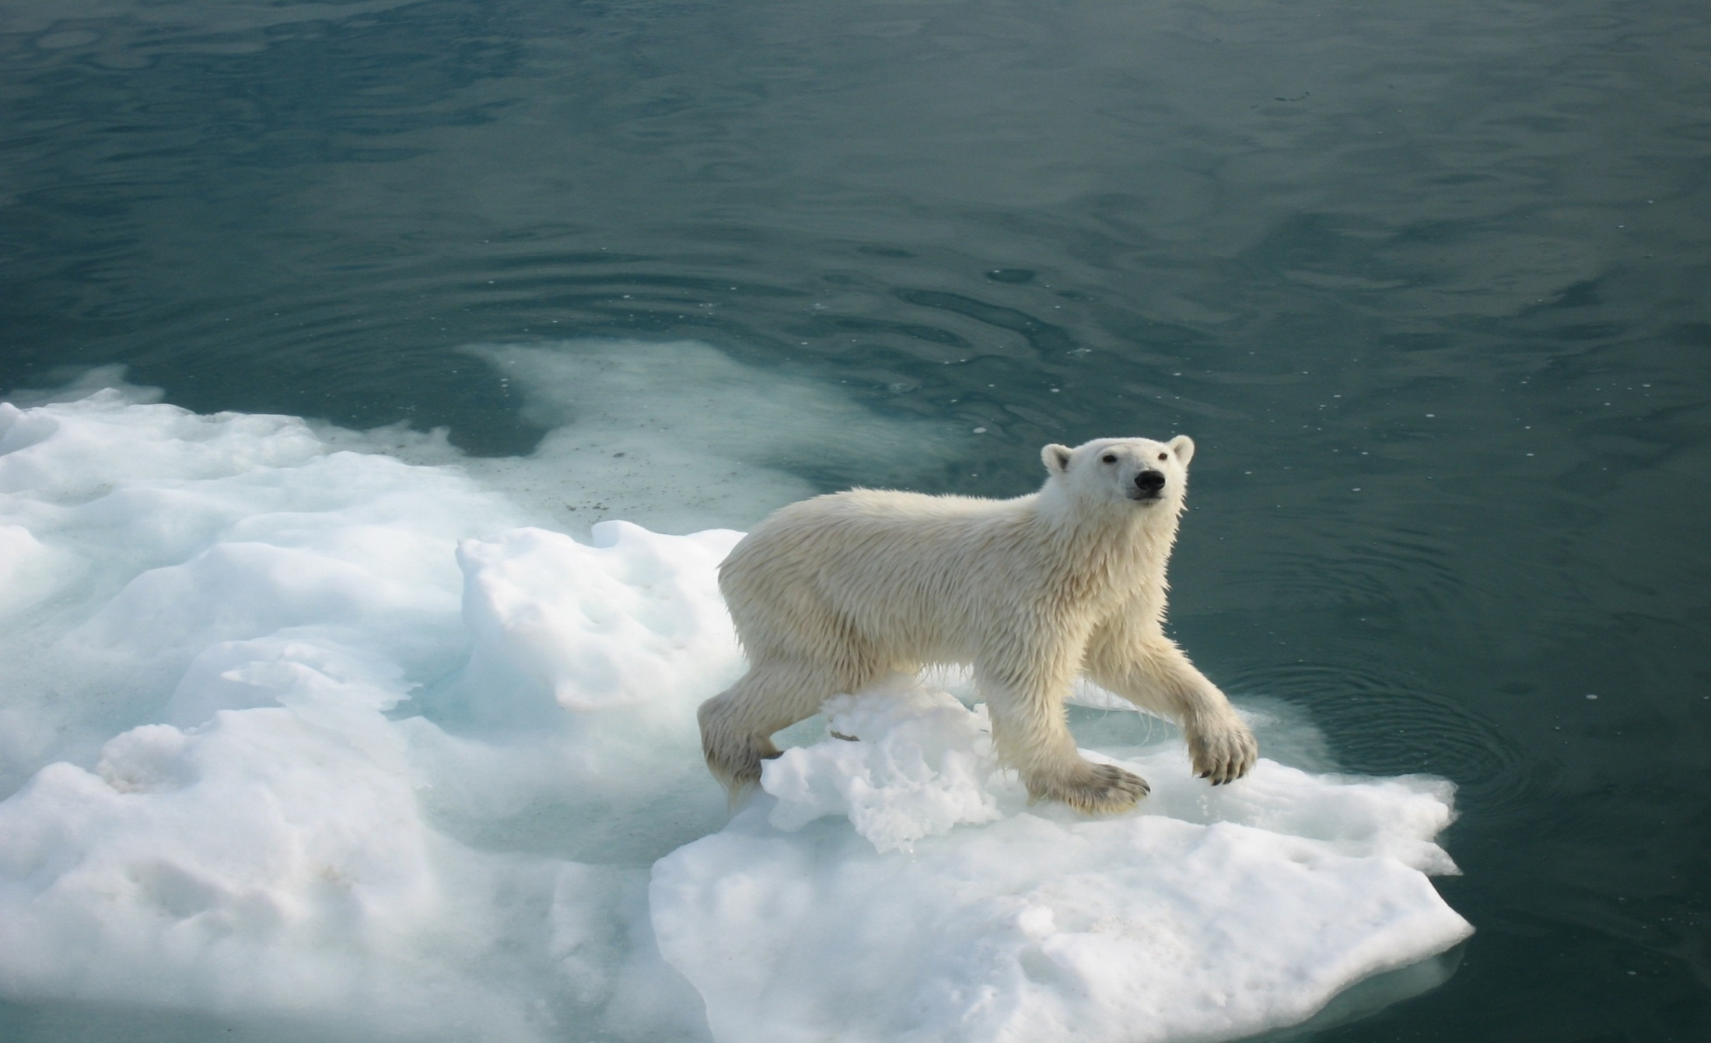
What is global warming?
Global Warming is the theory that we as humans are increasing greenhouse gases through industrialization causing more gases and increasing the amount of sunlight that gets caught and heats the Earth.
Notes:
3

Slide 4
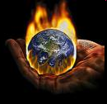
Over the past few centuries, people have been burning more amounts of fuels such as coal, oil, natural gas and gasoline. The gases such as carbondioxide, formed by the burning, are building up in the atmosphere and act like greenhouse gases. These greenhouse gases which cover the atmosphere like a thickening blanket, trap the sun’s heat and causing the planet to warm up.

Slide 5
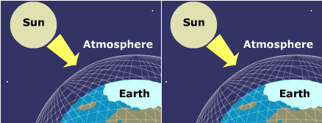
The Greenhouse Effect traps heat inside the Earth’s atmosphere. This causes our climate increasing in temperature. This is known as Global Warming.

Slide 6
KEY WORDS
Greenhouse gases :- the thick layer of gases that catches the sun’s rays and heats the earth. Eg:- carbondioxide,methane.
Industrialization :- to adapt a country or group to industrial methods of production and manufacturing.
Gasolene :- U.S.petroleum
Fuel :- a source which provides energy

Slide 7
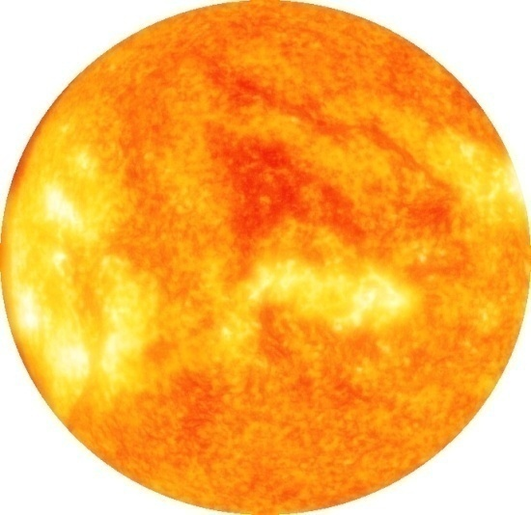

Example of the Greenhouse Effect
The Sun’s energy passes through the car’s windshield.
This energy (heat) is trapped inside the car and cannot pass back through the windshield, causing the inside of the car to warm up.
Notes:
7

Slide 8
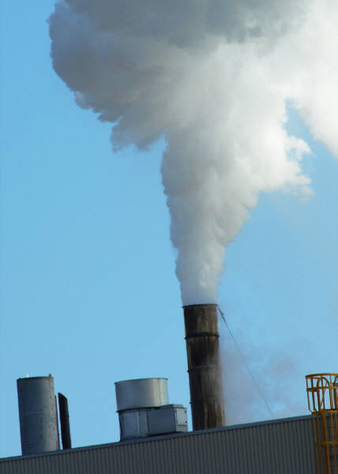
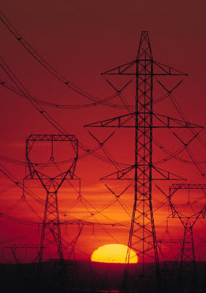
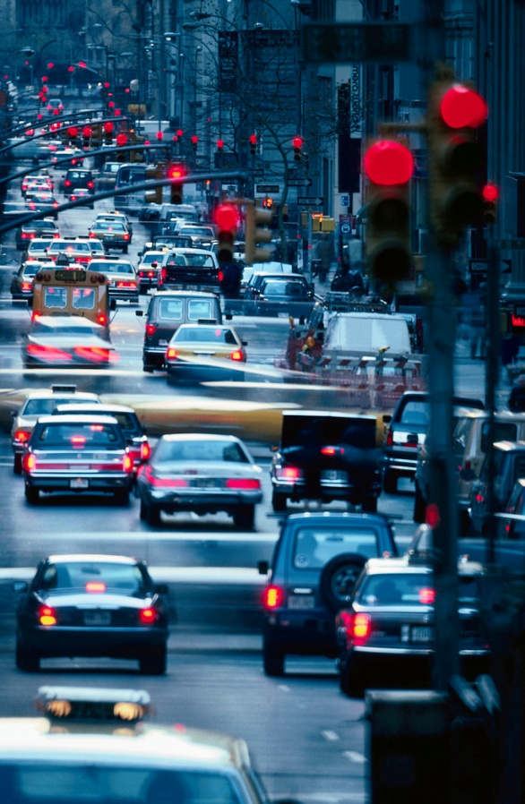
Why is global warming happening?
Pollution from coal, natural gas, and oil
Pollution from coal, natural gas, and oil
Pollution from coal, natural gas, and oil
Notes:
8

Slide 9
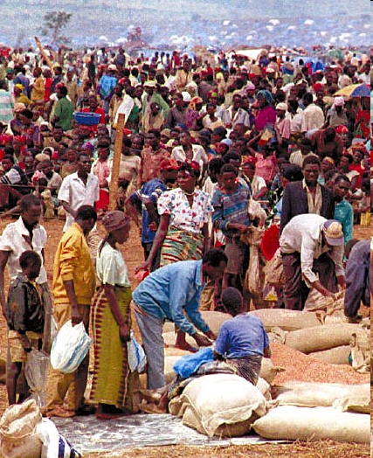
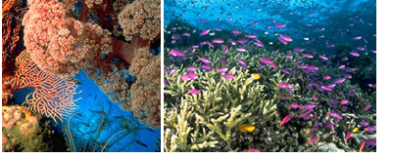
Global Human Environmental Threats
.Overpopulation
.Loss of biodiversity

Slide 10
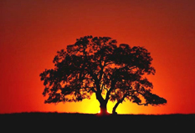
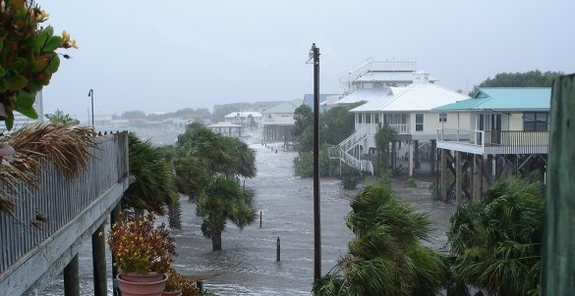
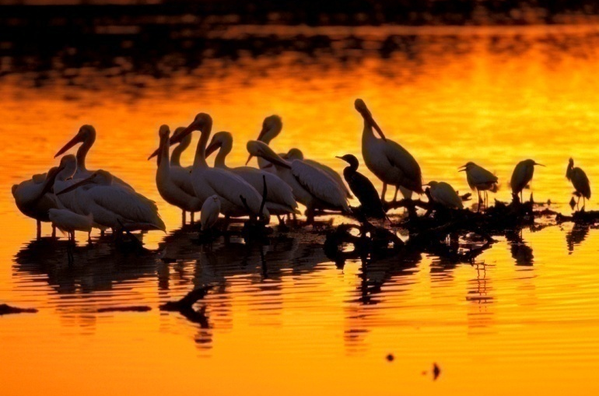
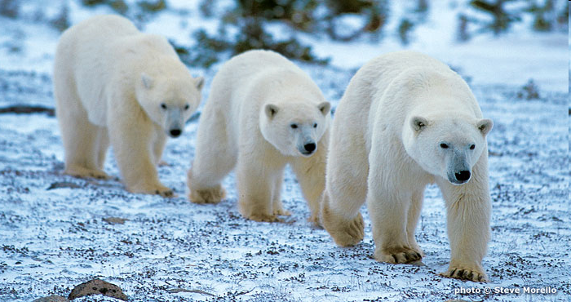
Effects of Global Warming
Increased Temperature
Rising Sea Level
Habitat Damage and
Species Affected
Migration of animals
to poles
Notes:
10

Slide 11
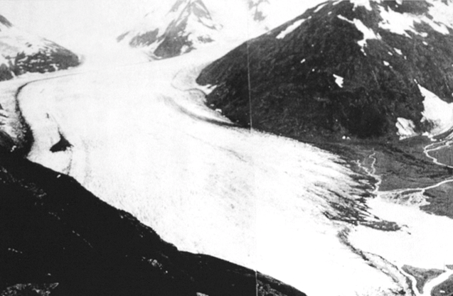
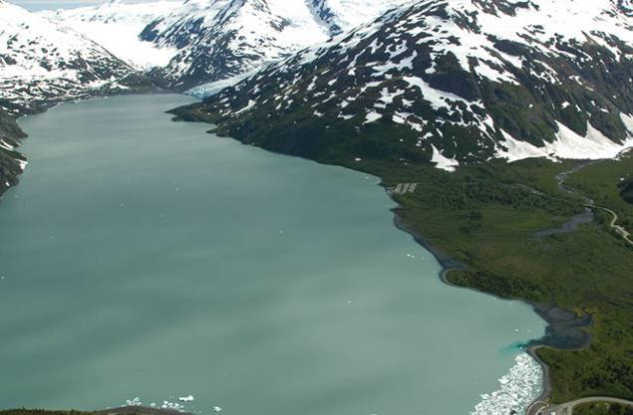
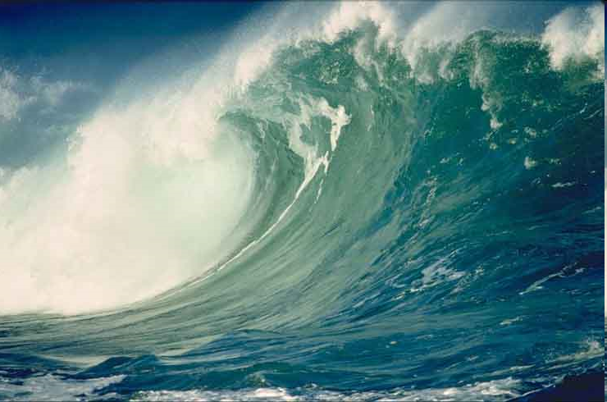
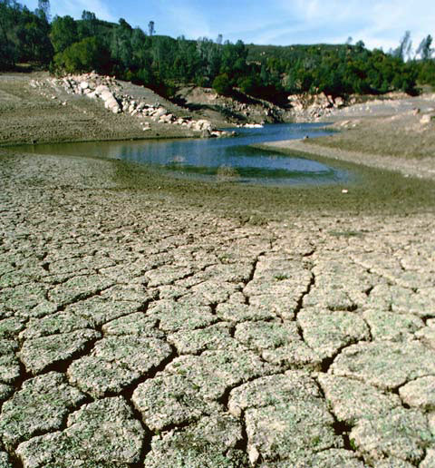
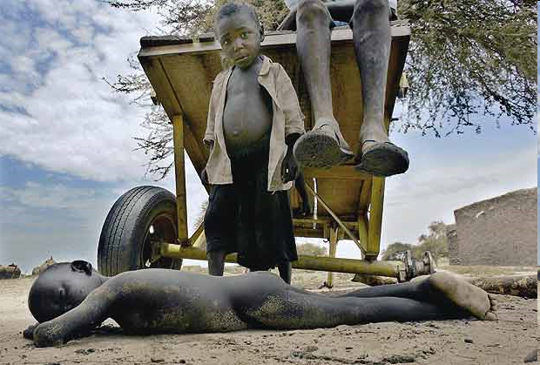
Glaciers are retreating
Alaska
1914
2015
Natural calamities are occuring
Flood
Drought
Famine
Notes:
11

Slide 12


The truth unfortunately

Slide 13
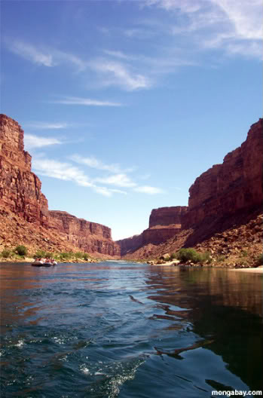
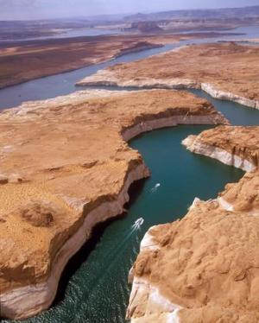
COLORADO RIVER
1999
2014

Slide 14

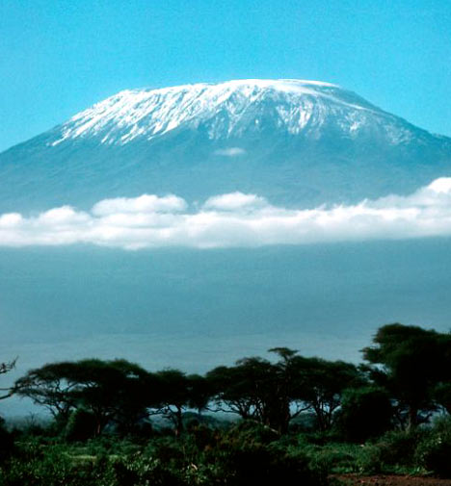
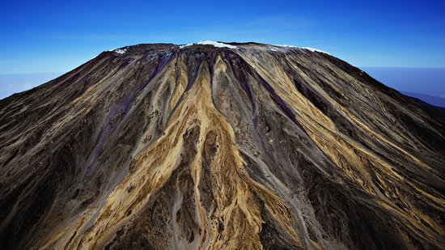
Mt . KILIMANJARO
1995
2015

Slide 15
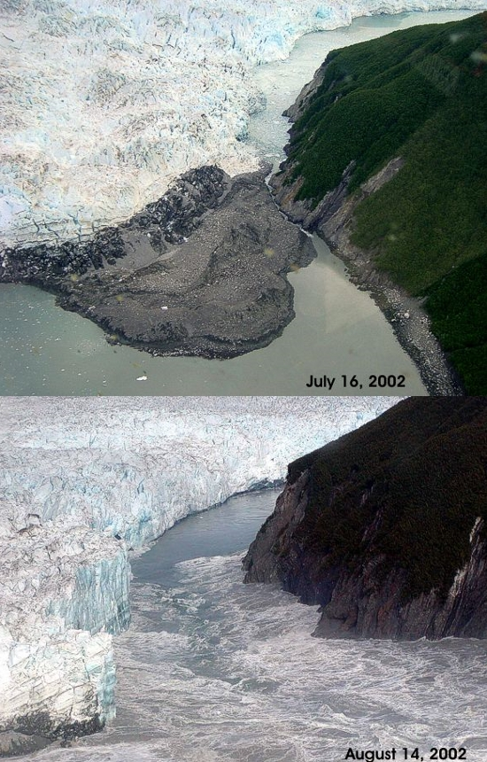
ALPS GLACIER

Slide 16
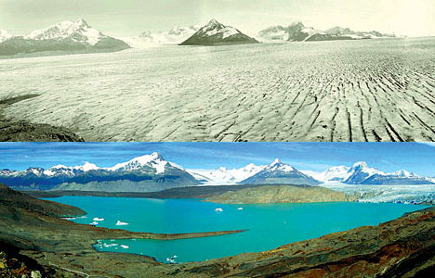
ARGENTINA ICE
2O04
2012

Slide 17
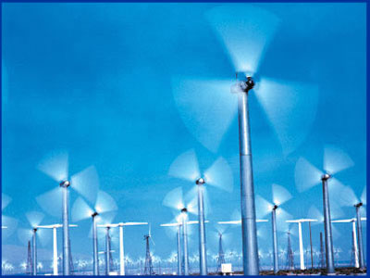
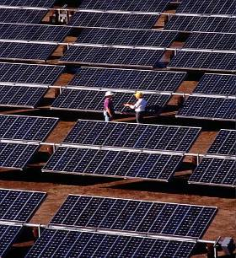
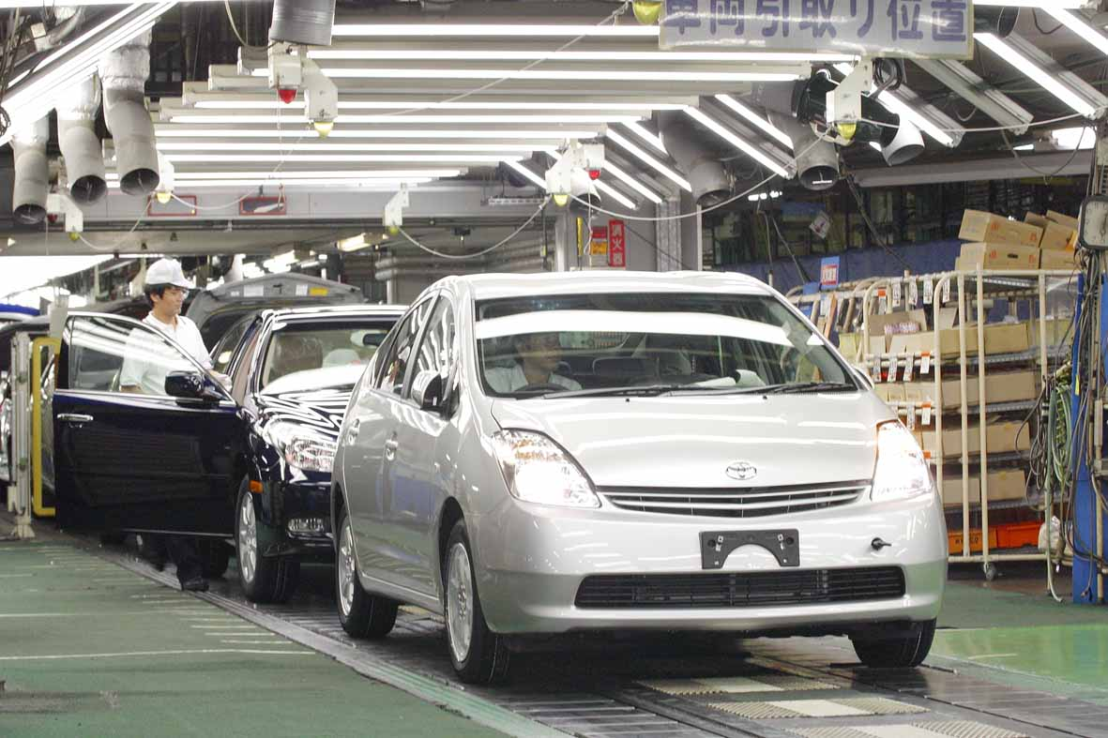
What’s being done now to reduce our emissions?
Wind Power
Solar Power
Fuel-Efficiency
Notes:
17

Slide 18
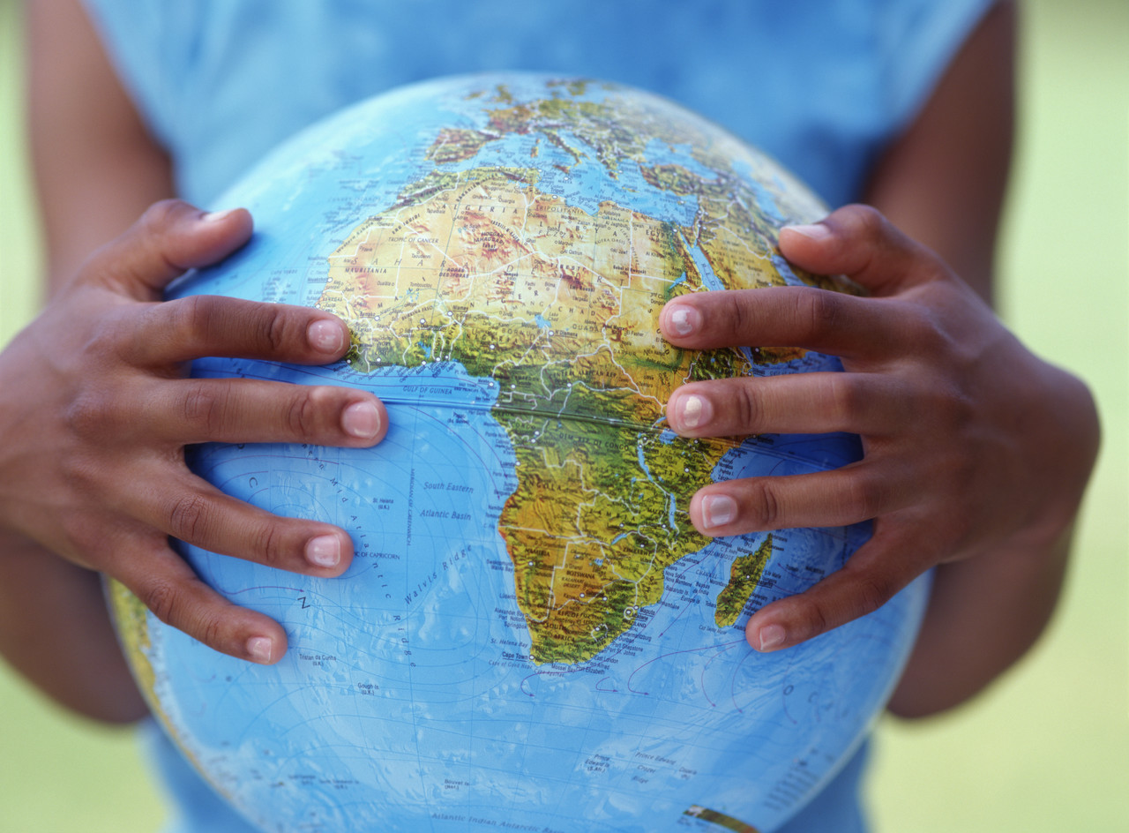
What can we do to solve the problem?
1. Reduce fossil fuel consumption
2. Avoid burning of plastic
3. Energy conservation
4. Afforestation
5. Control population growth
Notes:
18

Slide 19
Comprehension Questions
What is Global Warming ?
What are the causes of Global Warming ?
What are the effects of Global Warming ?
How can we overcome this threat ?

Slide 20



